Slide 1
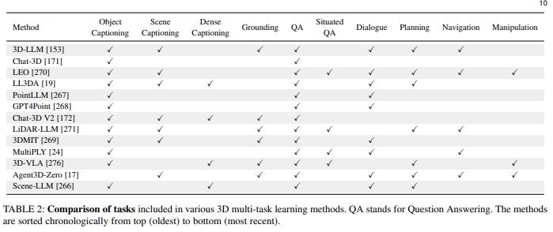
When LLMs step into the 3D World: A Survey and Meta-Analysis of 3D Tasks via Multi-modal Large Language Models
Paper link: https://arxiv.org/pdf/2405.10255
Take home message
MLLMs are effective at learning 3D data. Shows current methodologies and datasets for training 3D data into MLLMs.
Interesting figures
Other notes
Not really relevant to VLGFM. Tags:
Foundational reading

Slide 2
(Not Read) Towards Vision-Language Geo-Foundation Model: A Survey
Paper link: arxiv.org/abs/2406.09385
Take home message
Interesting figures
Other notes
Tags:

Slide 3
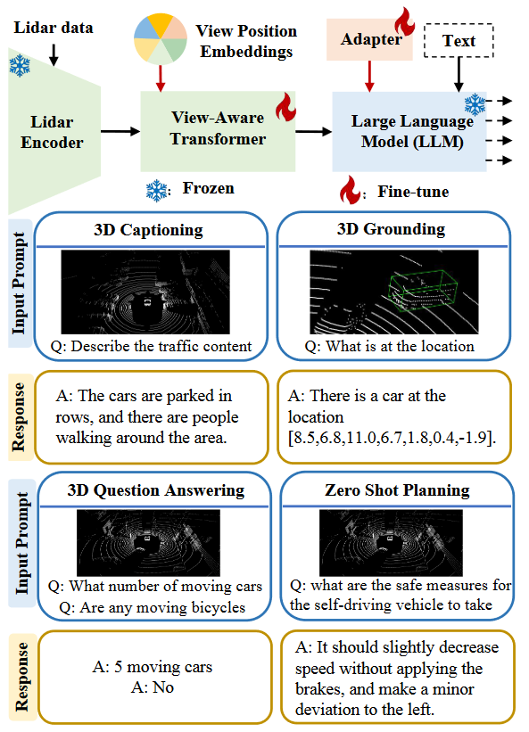
LiDAR-LLM: Exploring the Potential of Large Language Models for 3D LiDAR Understanding
Paper link: https://arxiv.org/abs/2312.14074
Take home message
Geospatial models are possible on moving objects
Interesting figures
Architecture on the right
Other notes
We can take the datasets from here
Tags: Vehicle Sensors

Slide 4
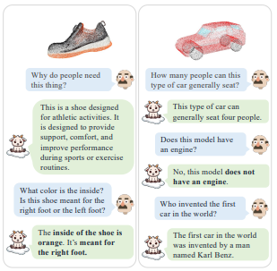
(Skimmed) PointLLM: Empowering Large Language Models to Understand Point Clouds
Paper link: https://arxiv.org/abs/2308.16911
Take home message
Shows LLMs amazing ability to learn 3D objects
Interesting figures
Other notes
Relevant but unimportant Tags:
Unimportant

Slide 5
(Not Read) Very high resolution canopy height maps from RGB imagery using self-supervised vision transformer and convolutional decoder trained on Aerial Lidar
Paper link: https://arxiv.org/abs/2304.07213
Take home message
Interesting figures
Other notes
Tags:

Slide 6
(Not Read) EarthGPT: A Universal Multi-modal Large Language Model for Multi-sensor Image Comprehension in Remote Sensing Domain
Paper link: https://arxiv.org/pdf/2401.16822
Take home message
Interesting figures
Other notes
Tags:

Slide 7
(Not Read) SkyEyeGPT: Unifying Remote Sensing Vision-Language Tasks via Instruction Tuning with Large Language Model
Paper link: https://arxiv.org/abs/2401.09712
Take home message
Interesting figures
Other notes
Tags:

Slide 8
(Not Read) ChangeCLIP: Remote sensing change detection with multimodal vision-language representation learning
Paper link: https://www.sciencedirect.com/science/article/abs/pii/S0924271624000042
Take home message
Interesting figures
Other notes
Tags:

Slide 9
(Not Read) Remote Sensing ChatGPT: Solving Remote Sensing Tasks with ChatGPT and Visual Models
Paper link: https://arxiv.org/abs/2401.09083
Take home message
Interesting figures
Other notes
Tags:

Slide 10
(Not Read) Vision-Language Models in Remote Sensing: Current Progress and Future Trends
Paper link: https://arxiv.org/abs/2305.05726
Take home message
Interesting figures
Other notes
Tags:

Slide 11
(Skimmed) Revolutionizing Visual Description: Integrating LiDAR Data for Enhanced Language Models
Paper link: https://docs.google.com/document/d/1iNSNmw4EwpI1qQPXyKHr1lXMKq_fsiFh/edit?usp=drive_link&ouid=111235722507289281793&rtpof=true&sd=true
Take home message
It describes LiDAR in LLMs
Interesting figures
Other notes
Relevant but skimmed, there are other more important. Has very few images. Tags:
Non-important

Slide 12
Paper title
Paper link:
Take home message
Interesting figures
Other notes
Tags:

Slide 13
Paper title
Paper link:
Take home message
Interesting figures
Other notes
Tags:

Slide 14
Paper title
Paper link:
Take home message
Interesting figures
Other notes
Tags:

Slide 15
Paper title
Paper link:
Take home message
Interesting figures
Other notes
Tags:

Slide 16
Paper title
Paper link:
Take home message
Interesting figures
Other notes
Tags:

Slide 17
Paper title
Paper link:
Take home message
Interesting figures
Other notes
Tags:

Slide 18
Paper title
Paper link:
Take home message
Interesting figures
Other notes
Tags:

Slide 19
Paper title
Paper link:
Take home message
Interesting figures
Other notes
Tags:

Slide 20
Paper title
Paper link:
Take home message
Interesting figures
Other notes
Tags:

Slide 21
Paper title
Paper link:
Take home message
Interesting figures
Other notes
Tags:

Slide 22
Paper title
Paper link:
Take home message
Interesting figures
Other notes
Tags:

Slide 23
Paper title
Paper link:
Take home message
Interesting figures
Other notes
Tags:

Slide 24
Paper title
Paper link:
Take home message
Interesting figures
Other notes
Tags:

Slide 25
Paper title
Paper link:
Take home message
Interesting figures
Other notes
Tags:

Slide 26
Paper title
Paper link:
Take home message
Interesting figures
Other notes
Tags:

Slide 27
Paper title
Paper link:
Take home message
Interesting figures
Other notes
Tags:

Slide 28
Paper title
Paper link:
Take home message
Interesting figures
Other notes
Tags:

Slide 29
Paper title
Paper link:
Take home message
Interesting figures
Other notes
Tags:

Slide 30
Paper title
Paper link:
Take home message
Interesting figures
Other notes
Tags:

Slide 31
Paper title
Paper link:
Take home message
Interesting figures
Other notes
Tags:

